Slide 1
THG Simulations
Project update
Week 7
29/08/2023
David Amorim

Slide 2
Overview
Finished code handover document (sent via email; also on GitHub and Sync&Share)
set meeting to talk through the document and code?
Set up code to use for manuscript plots
no new COMSOL data yet (high Mach model of new and old chips)
in the following, showing sample manuscript plots with the old data
note: will need to compare measured to simulated pressures with new data!
Still to do: final report and presentation
waiting for new COMSOL data and manuscript plots first
For prelim plots (following): only Ar;
Think about shifting pressure?? -> also shift wavelength??
With final data: do all plots twice? Ne and Ar?
Ask for plot formatting feedback
Apart from changing plot layout, there is not much I can do right now without the new data

Slide 3
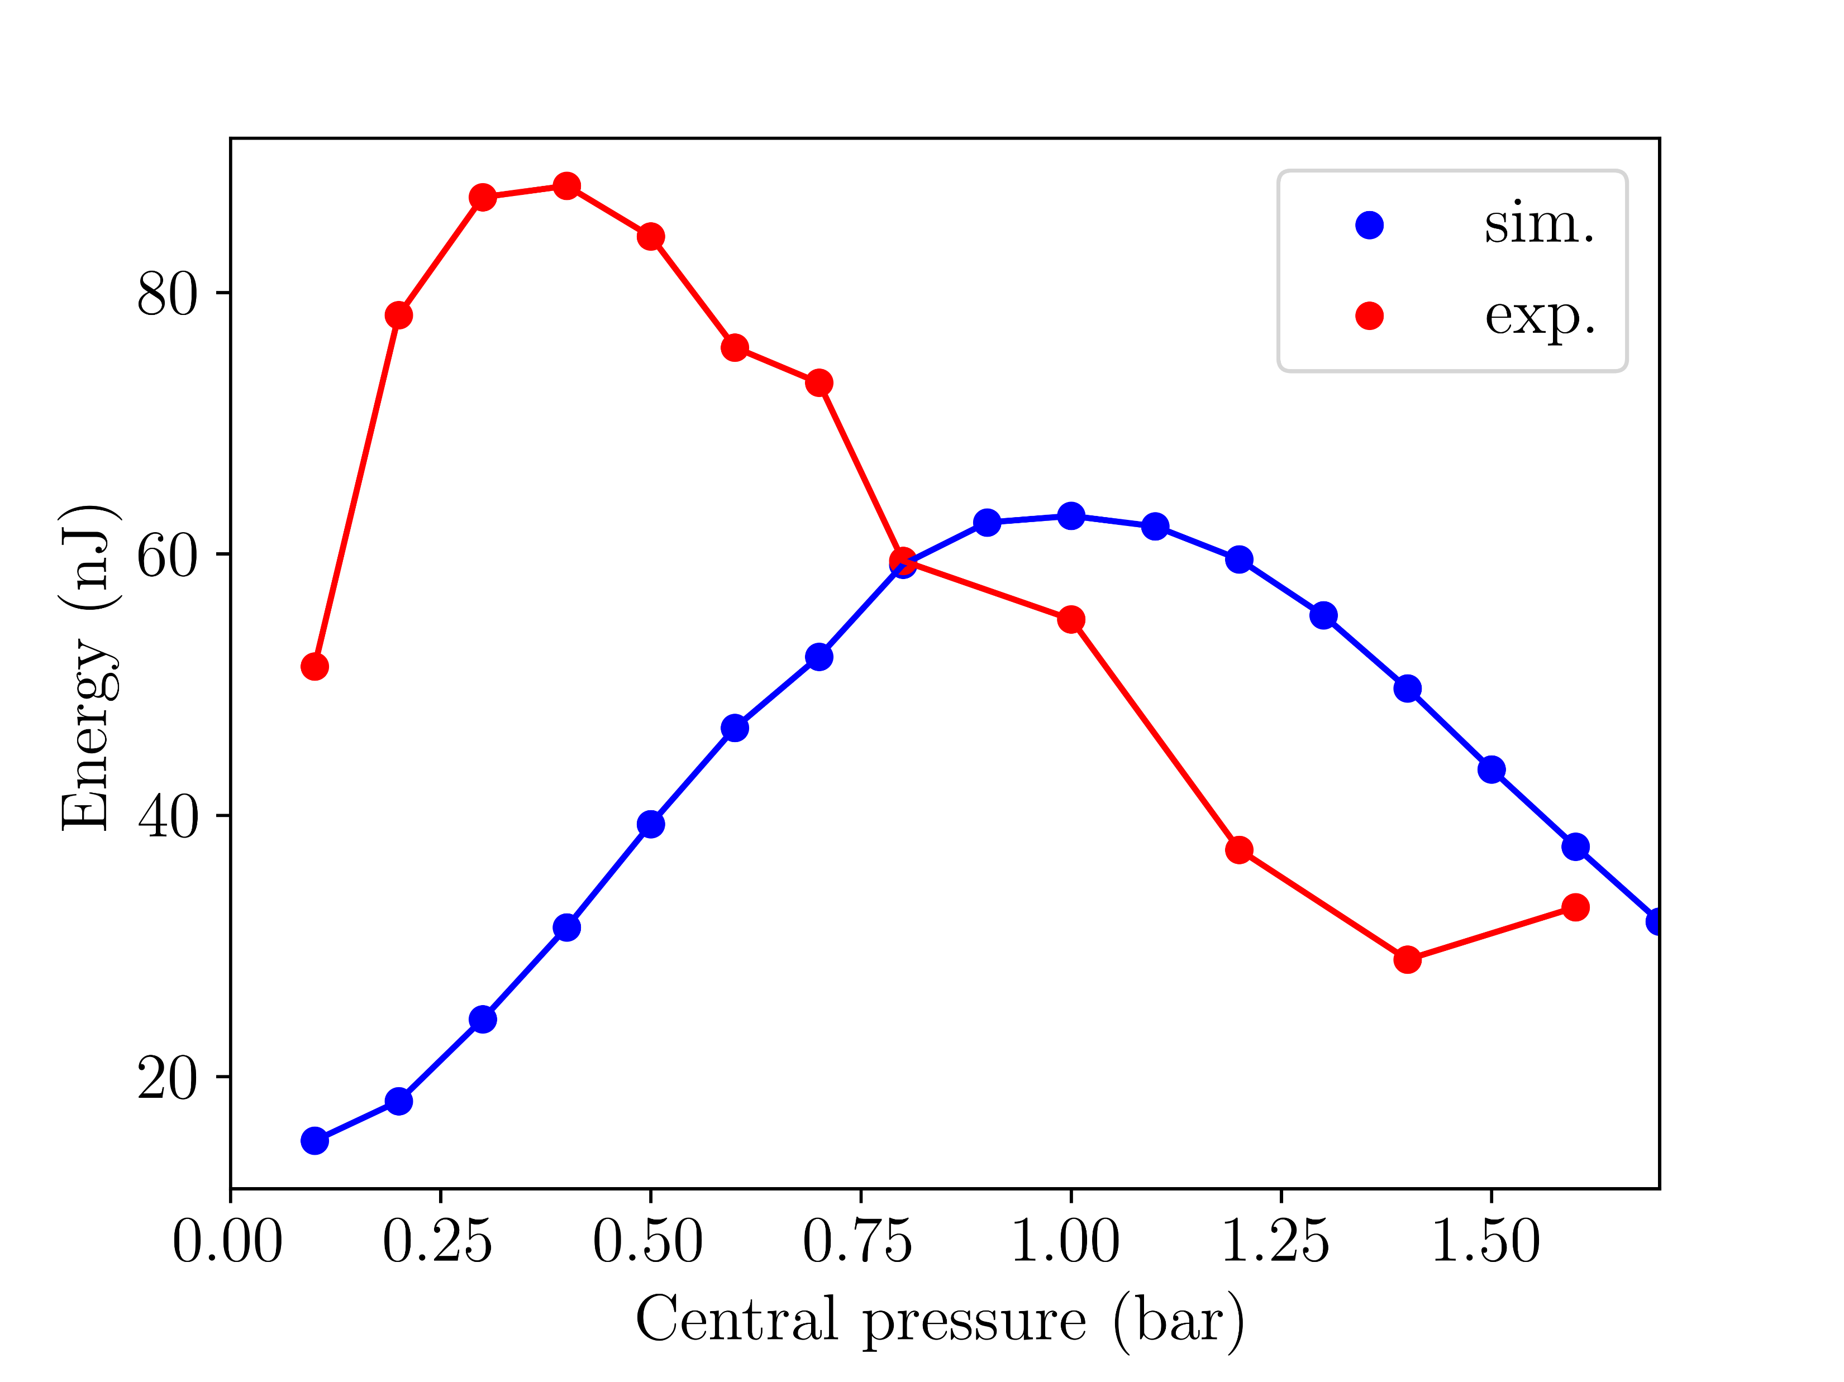
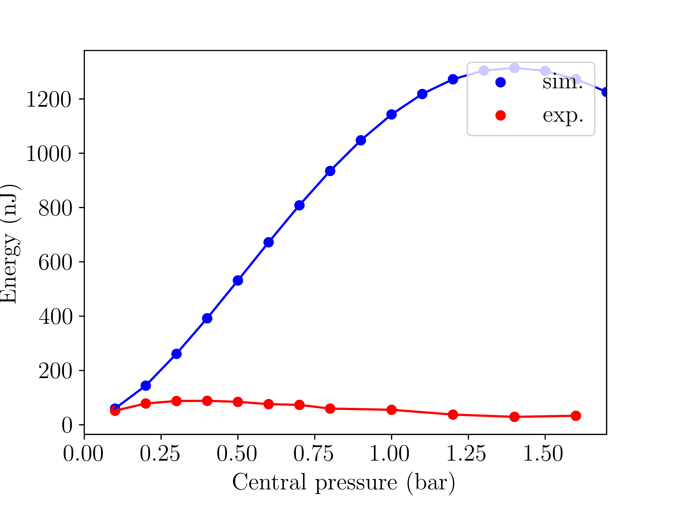
Sample manuscript plots
Notes:
repeat this with Ne at 400mW ?!
shift/rescale pressure axis?
A. Simulated pressure scan energies
Fig. 1a: Argon at 150mW (simulations with
COMSOL model)
Fig. 1b: Argon at 150mW (simulations with
gradient model)

Slide 4
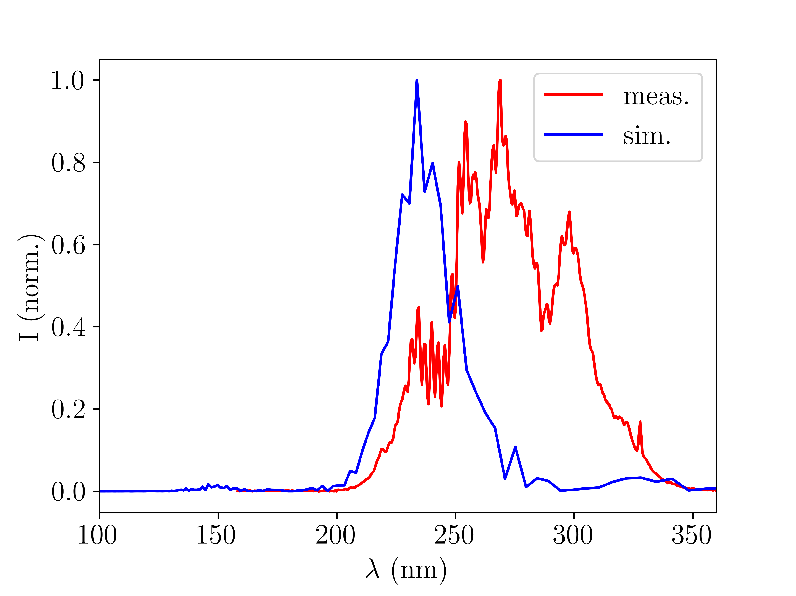
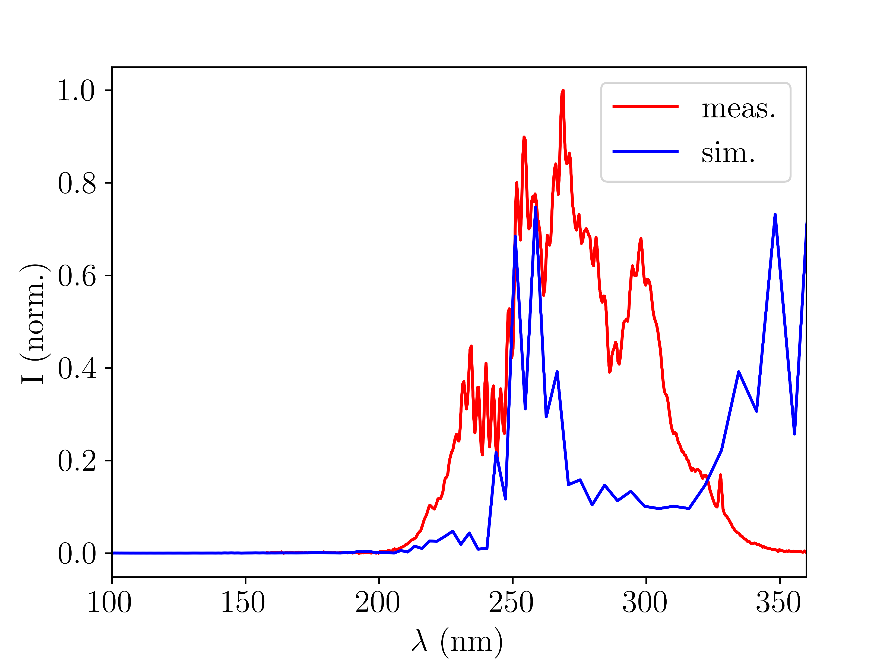
Sample manuscript plots
B. Simulated v. measured UV spectra
Fig. 2a: Argon at 150mW (simulations with
gradient model)
Fig. 2b: Argon at 150mW (simulations with
COMSOL model)

Slide 5
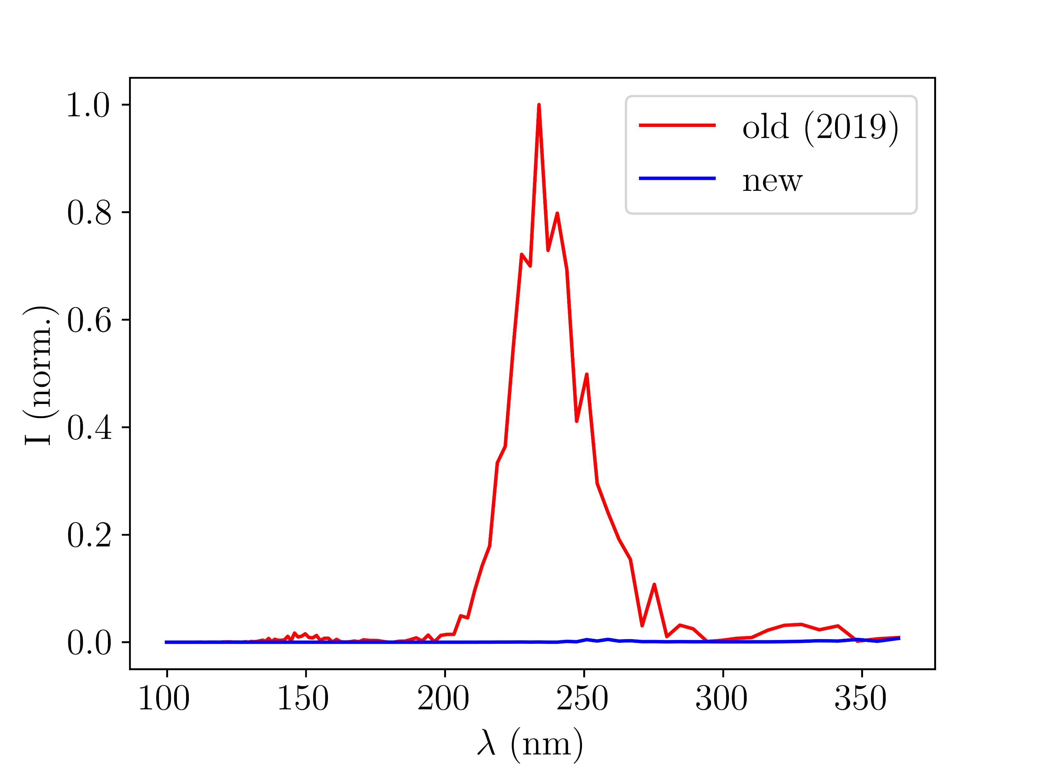
Sample manuscript plots
C. Simulated spectra: new chip v. old chip
Fig. 3: Argon at 150mW (simulations with
gradient model and COMSOL model of new chip instead of COMSOL of new and old)

Slide 6
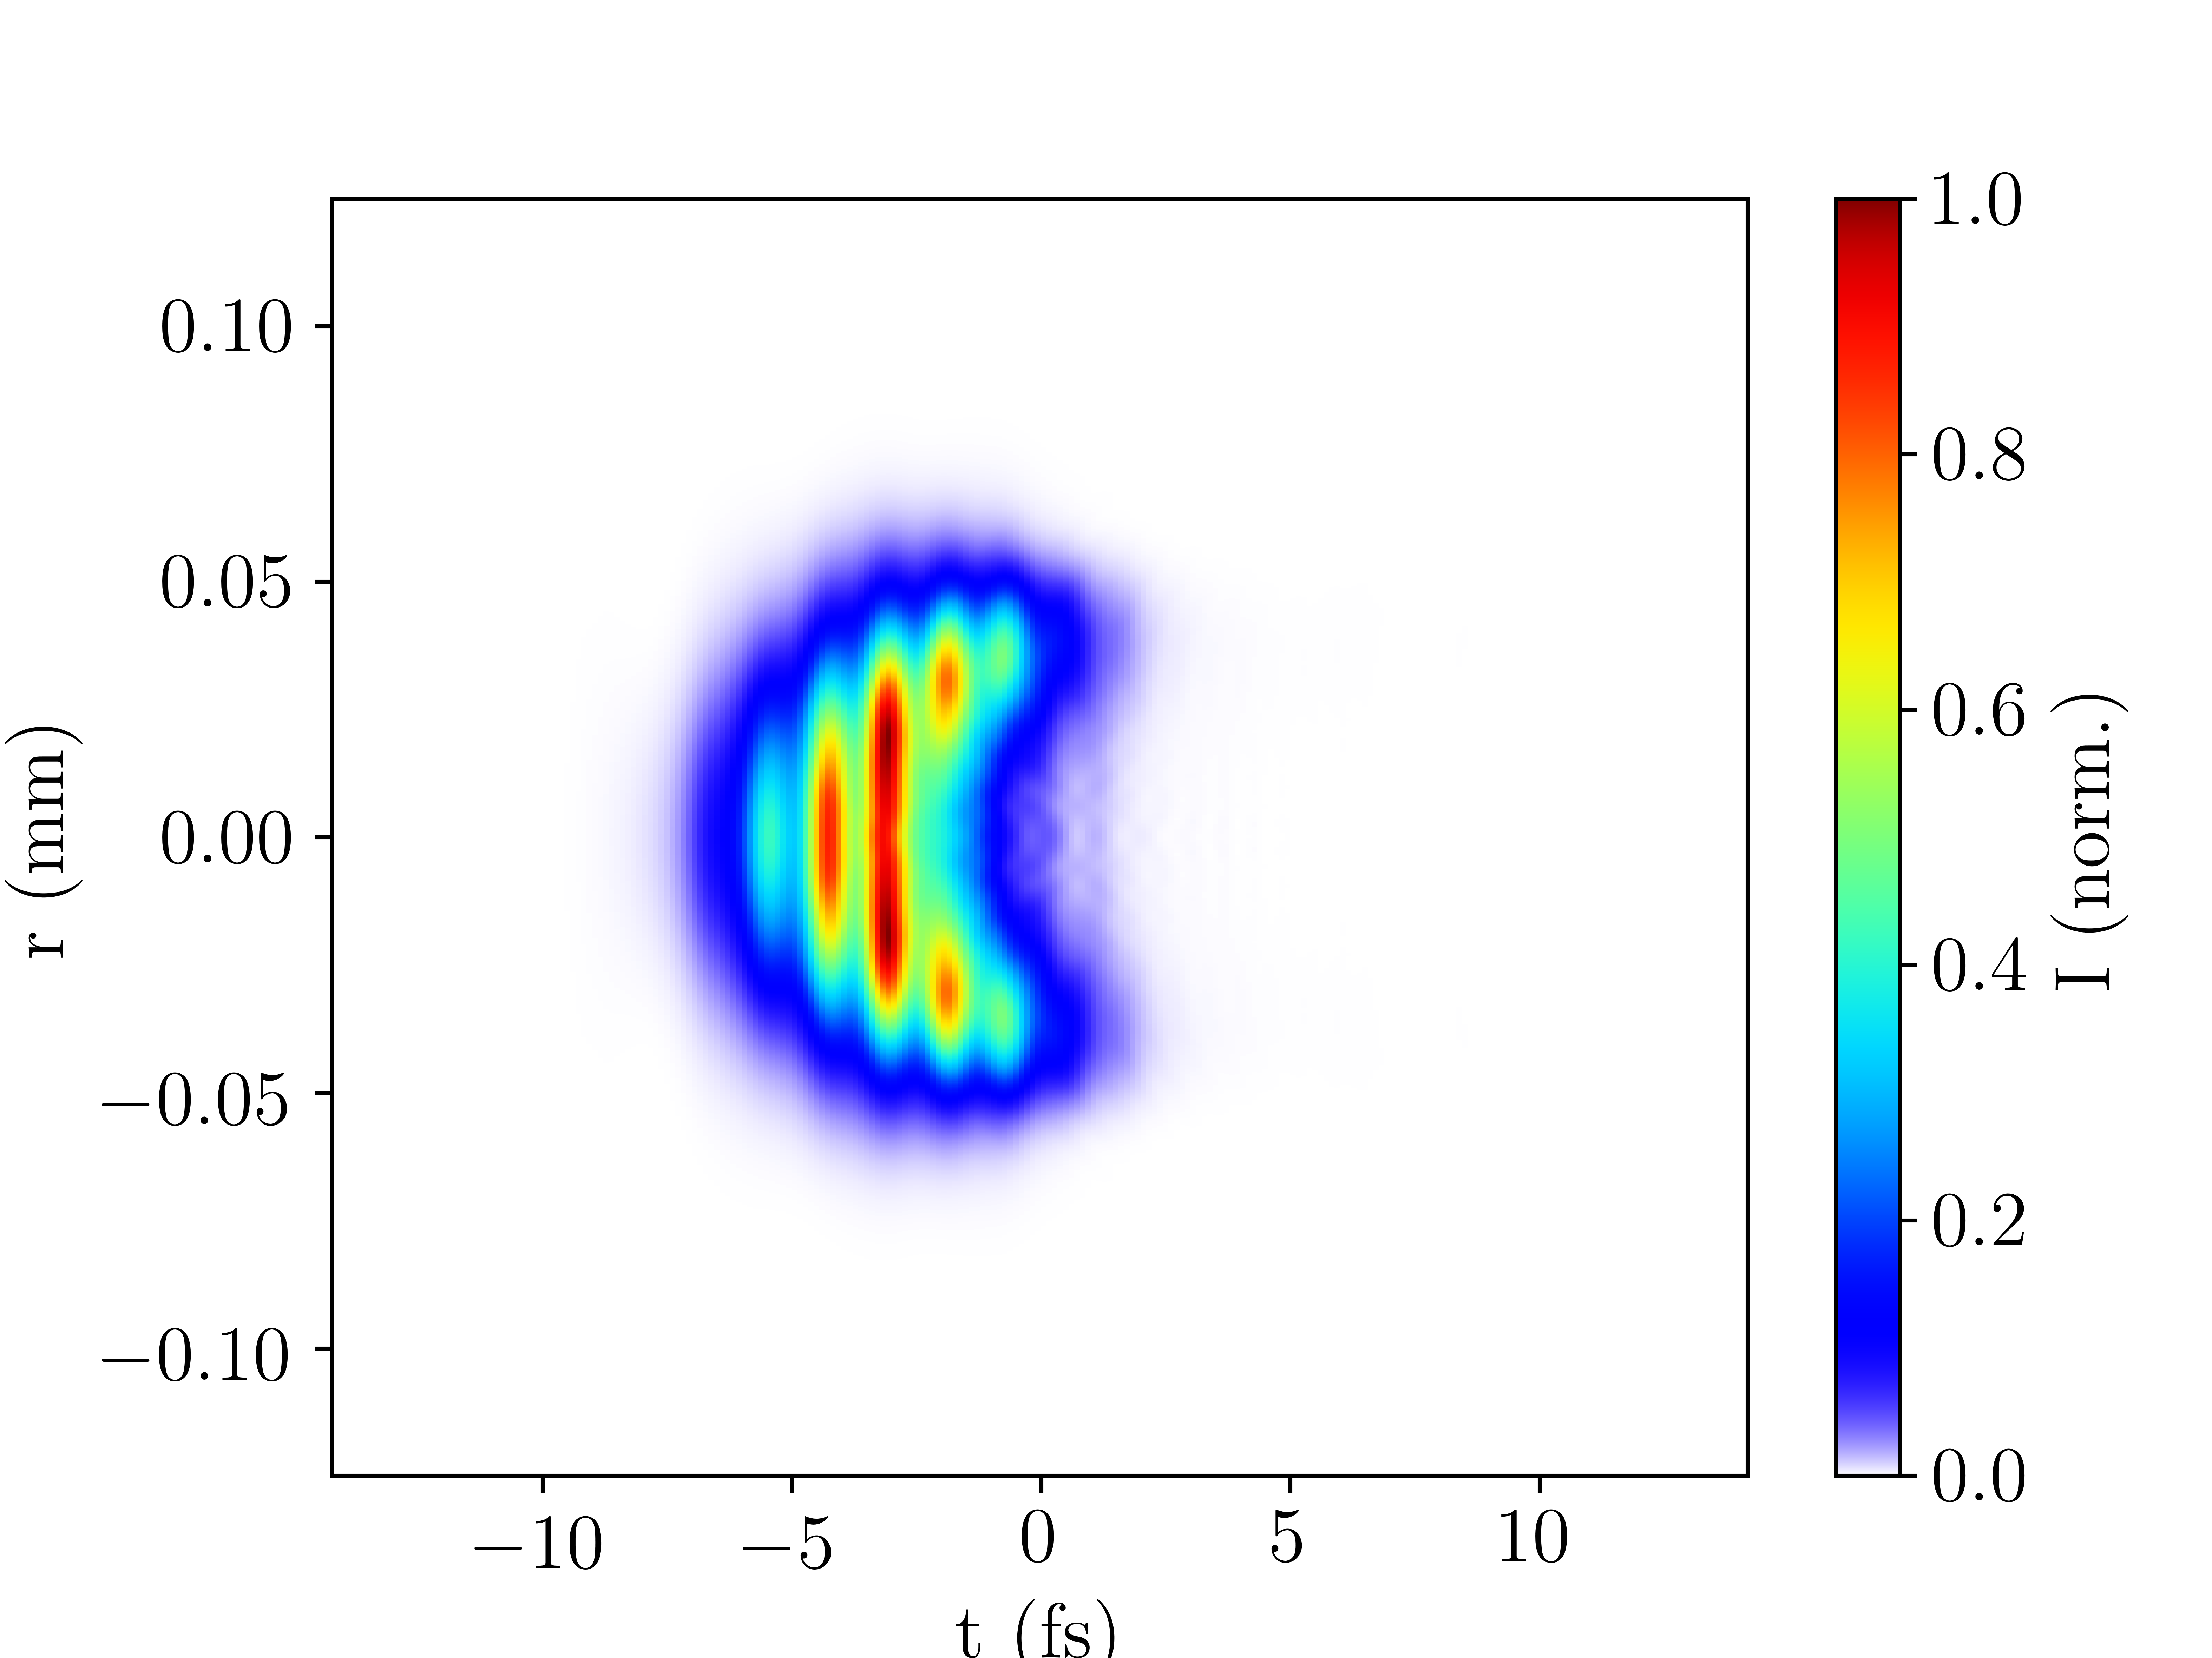
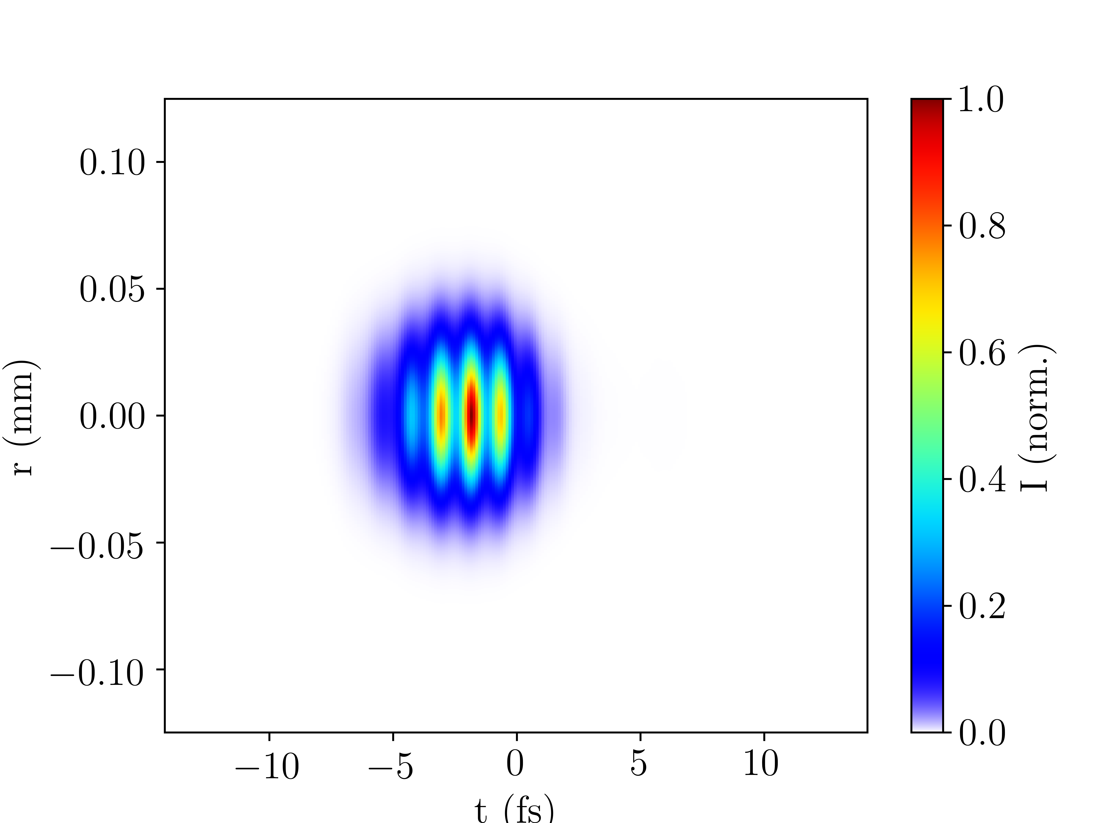
Sample manuscript plots
D. Spatiotemporal UV profile at output
Ar 150mW 0.4bar grad
ADD TL PULSE DURATION??
ion
no_ion

Slide 7
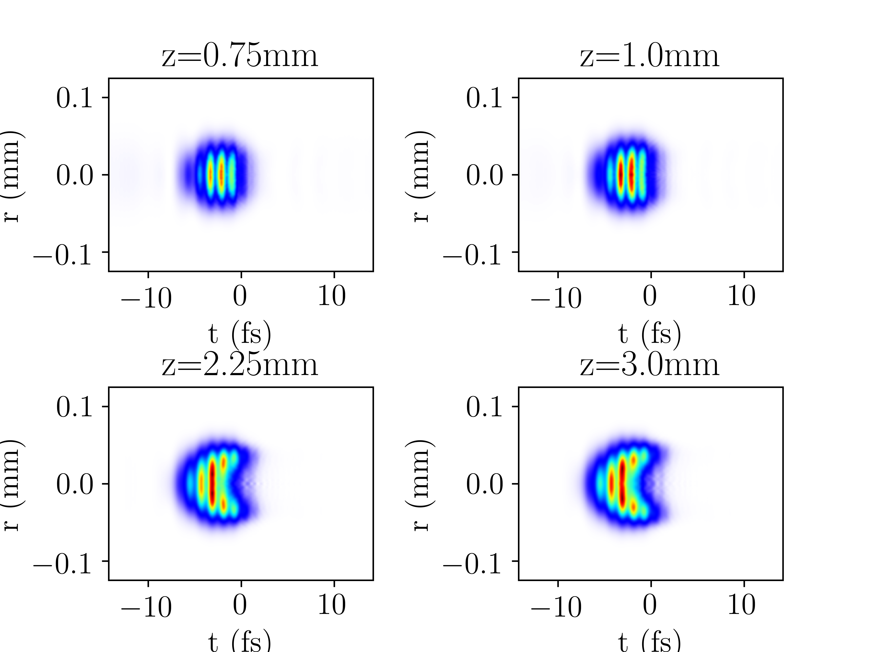
Sample manuscript plots
E. Spatiotemporal UV profile at different positions
Ar 150mW 0.4bar grad

Slide 8
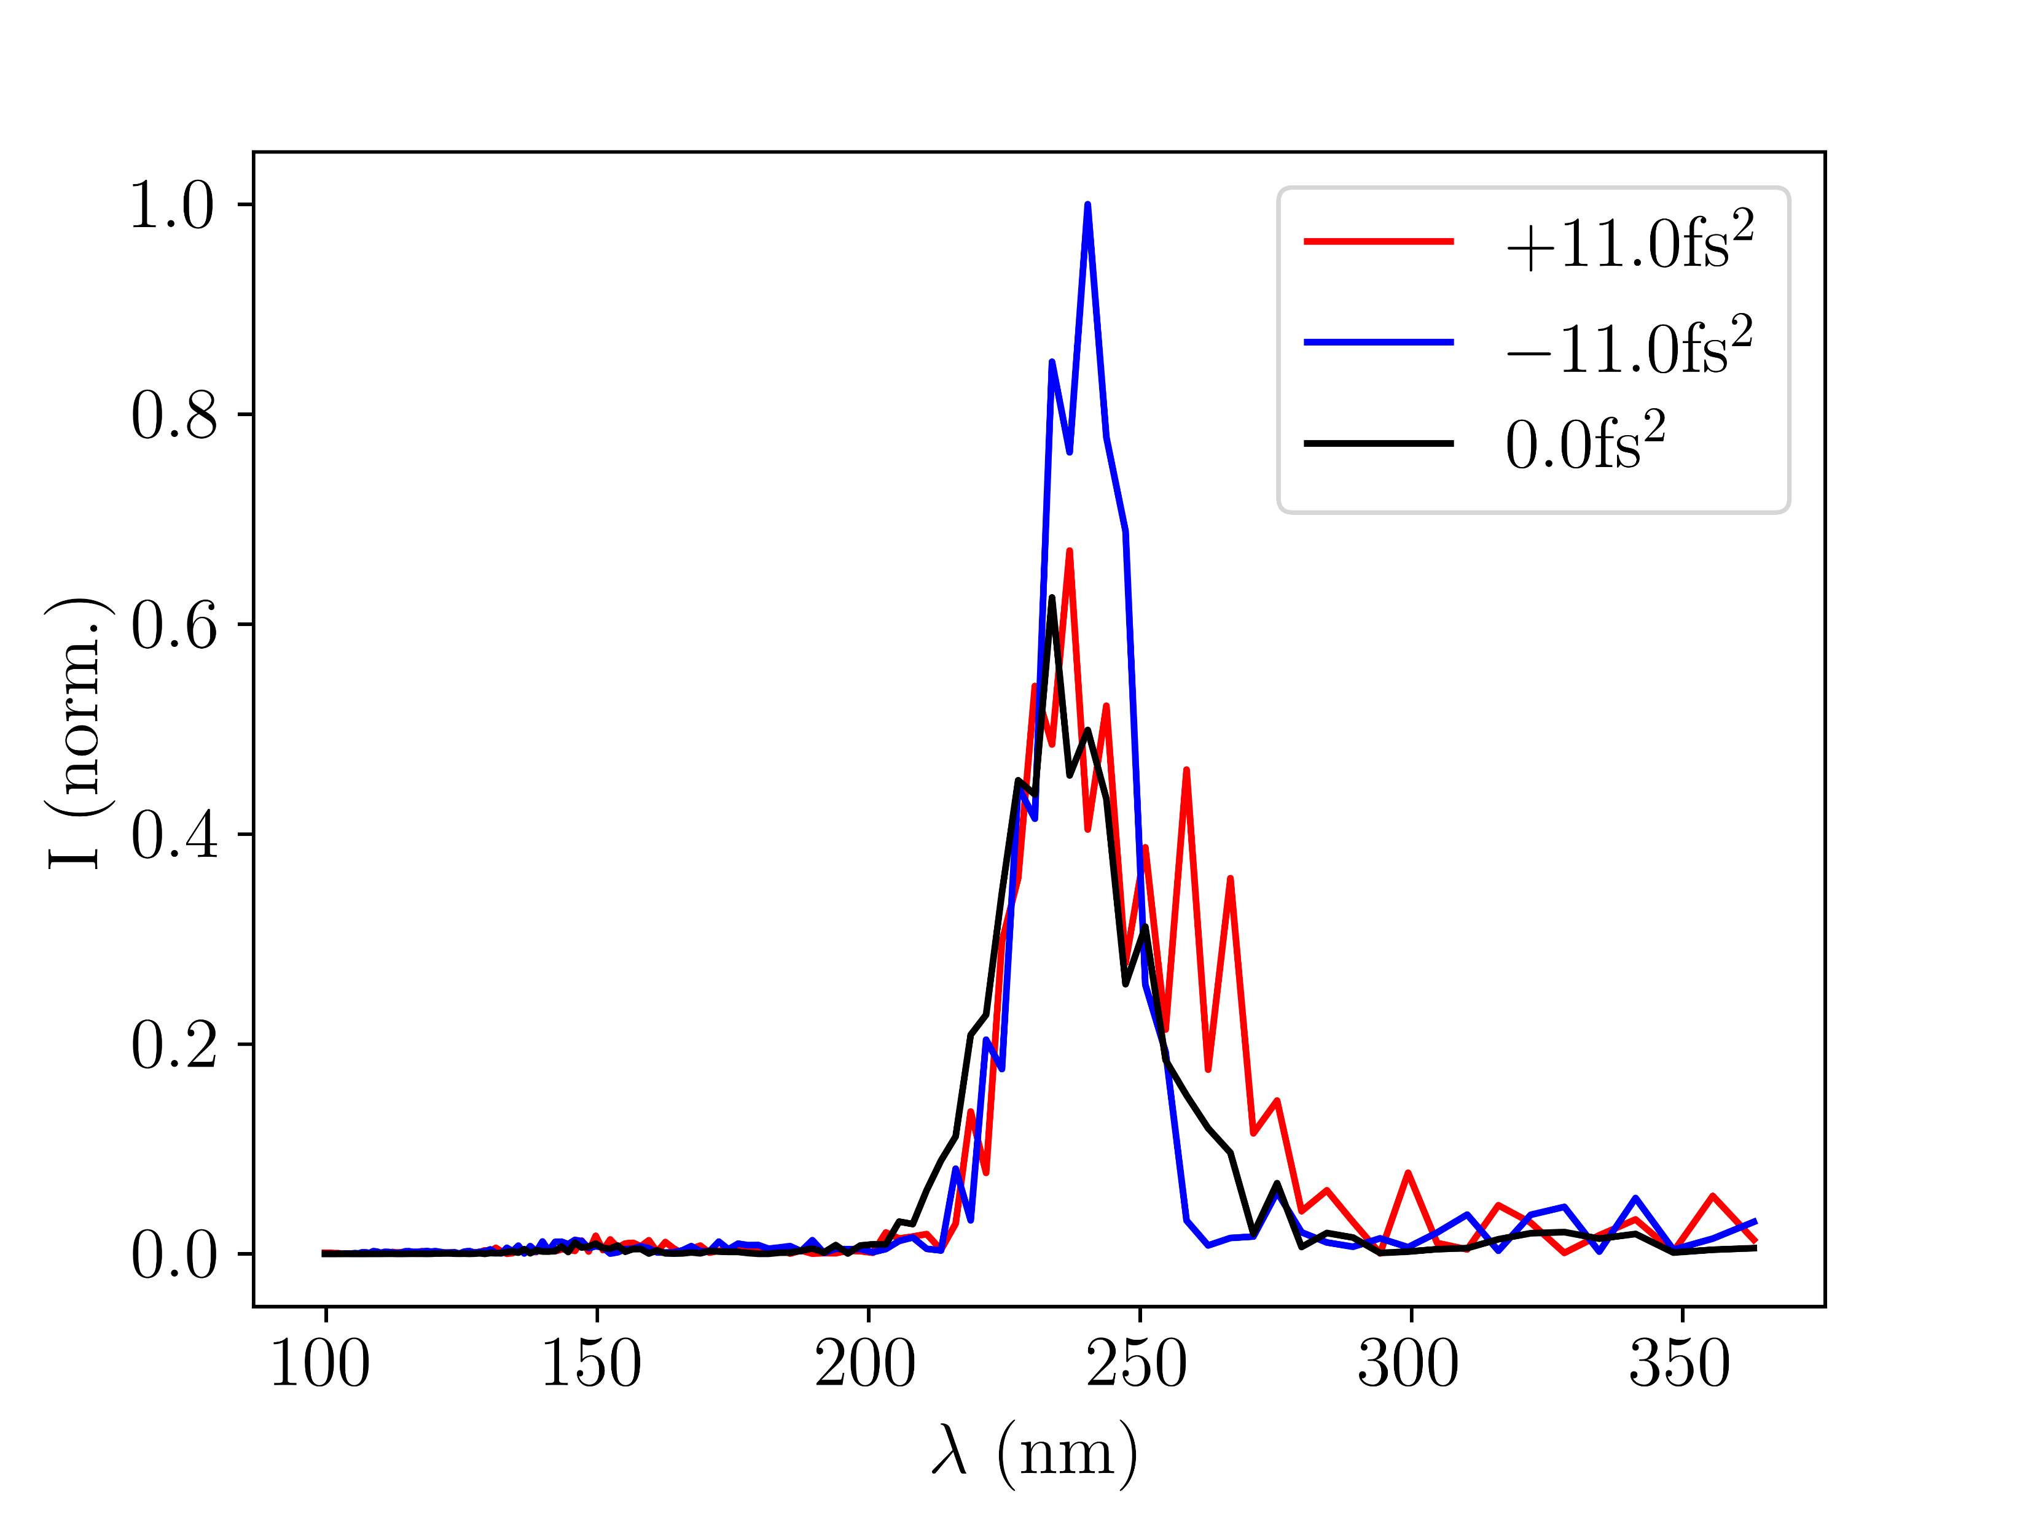
Sample manuscript plots
F. Effects of chirp
Ar 150mW 0.4bar grad

Slide 9
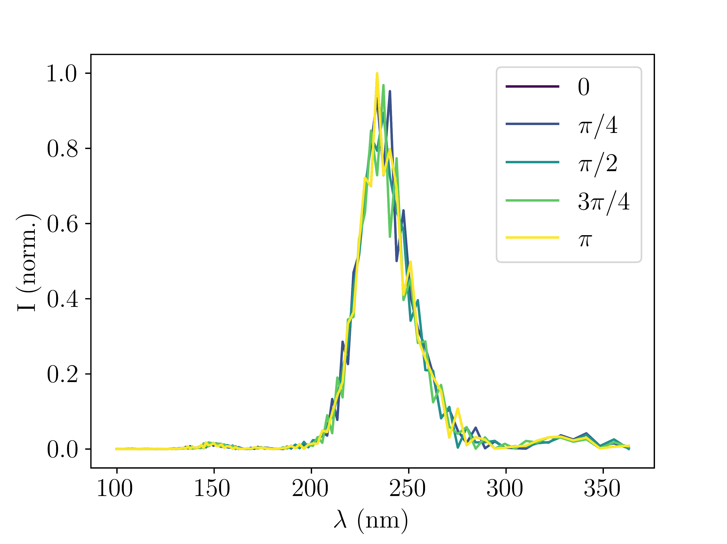
Sample manuscript plots
G. Effects of CEP
Ar 150mW 0.4bar grad

Slide 10
Find 10 best spectra?!
Note: plots E and F slightly cut at xlabel -> increase bottom !!

